Slide 1
History of computer
Made by Tanveer

Slide 2
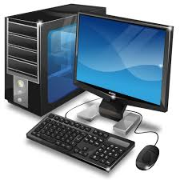
Definition of computer
A programmable electronic machine that accepts data (input), processes it according to stored instructions (software), and produces results (output) while also having the ability to store information for future use.

Slide 3
Earliest computer
Originally calculation was computed by humas, whose job title was computer.
These human computers were typically engaged in the calculation of
mathematical expression.
The first of word “computer”was record in 1613, referring to person who carried out calculation or computations, and the word continued to be used in that sence until the middle of the 20th.

Slide 4
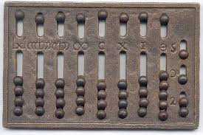
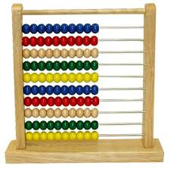
Abacus
An abacus is a mechanial device is used to Addition, Subtraction,
Multiplication and Division
The Abacus was invented by Mespotamians in 2400 BC
Earlier Abacus
Modern Abacus

Slide 5

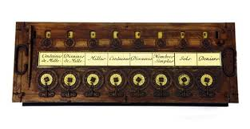
Pascaline
Invented by Blaise Pascal in 1642.
It was its limitation to addition and subtraction.
Its is too expensive
Pascaline
Blasie Pascal

Slide 6
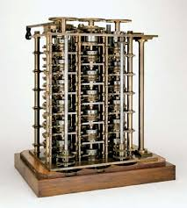
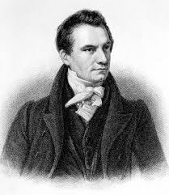
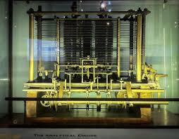
Difference Engine and analytical Engine
Its an atomatic mechanical calculator designed to tabulate
polynomial functions
Invented by Charles Babbage (Father of computer) in
1922 and 1834
It is first mechanical computer
Difference engine
Charles babbage
Analytical engine

Slide 7
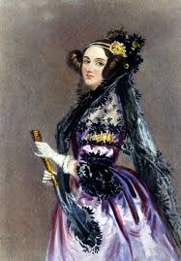
First Computer Programmer
In 1840 Augusta Ada Byron
suggest to Babbage that he
use the binary system.
She write’s programs for the
Analytical Engine
Augusta Ada Byron

Slide 8
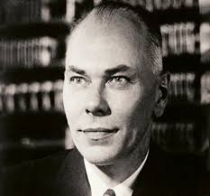
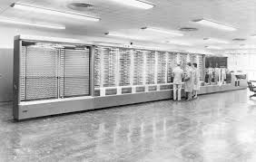
Harvard Mark 1
Also known as IBM Automatic sequence
controlled calculator (ASCC)
Invented by Howard H. Aikin in 1943
The first electro-mechanical computer.
Its is used in war effort during the last part of world war II.
Harvard Mark1
Harvard H.Aikin

Slide 9
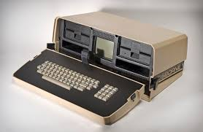
Osborne 1
The first portable computer.
Released in 1981 by the Osborne computer
Corporation
Its weight 24.5lb or 11.1Kg
Its cost US$1,795, and runs the CP/M 2.2
Operating System
Osbrne 1

Slide 10
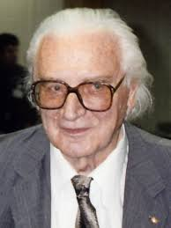
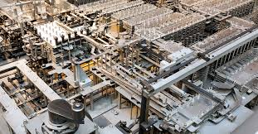
Z1
The first programmable computer.
Created by Konrad Zuses in Germany from 1936 to 1938
To Program the Z1 required that the user insert punch tape into a punch tape reader and all output was always generated through punch tape.
Z1
Konrad Zuses

